Slide 1
Finding common signatures for Parkinson’s Disease
21st June 2018

Slide 2
Whistle-stop tour around Parkinson’s Disease!
~150,00 individuals in the UK
Higher prevalence in men than women (1.5 times more likely)
Symptoms include stiff and slow movement, stooped posture, and tremors
Neuronal death of dopaminergic neurons predominantly in the substantia nigra
Evidence of cell death in brainstem areas
Other brain tissues show dysfunction despite no cell death (SN neurons hypothesised to be particularly vulnerable)
Associated genes include SNCA, LRRK2, GBA, PRKN, PINK1, PARK7, VPS35, EIF4G1, DNAJC13 and CHCHD2.

Slide 3
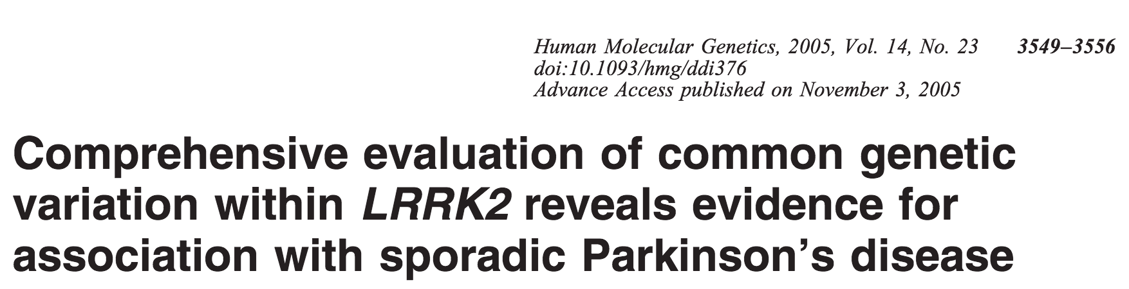
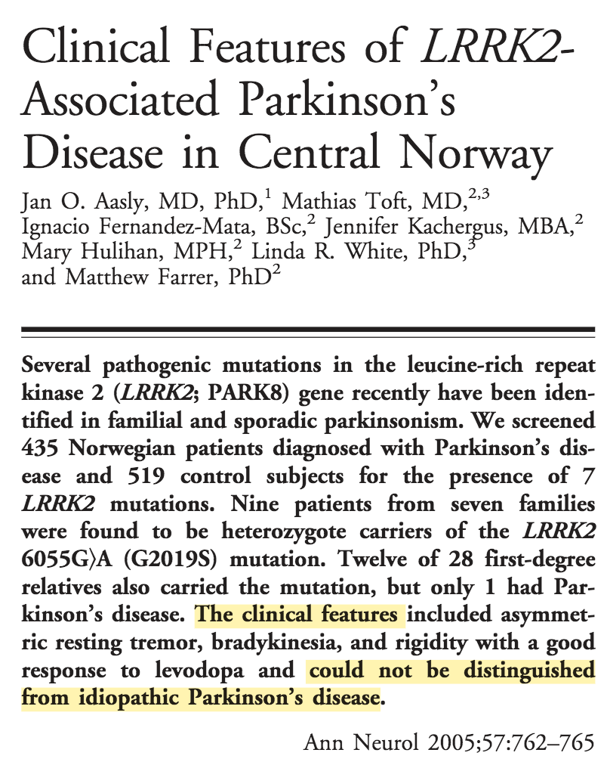



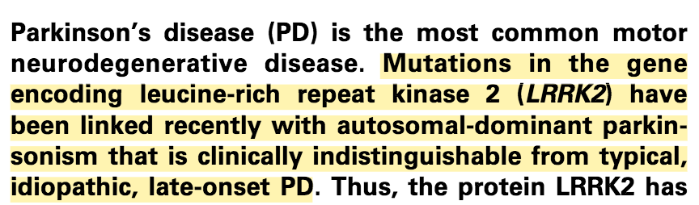
What common phenotype this time?
neuro-lab@sheffield.ac.uk

Slide 4
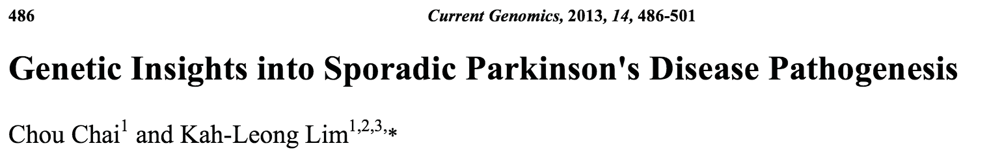
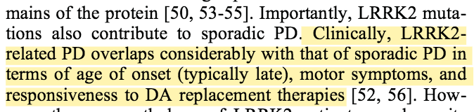
LRRK2 and Sporadic Parkinson’s Disease
Questions:
Why do LRRK2 familial and sporadic patients have such a similar phenotype?
What signature might they share?
Could this signature represent their late-onset/slow progressive nature?
If so, could that help us slow the progression of more aggressive PD cases?
Notes:
The

Slide 5
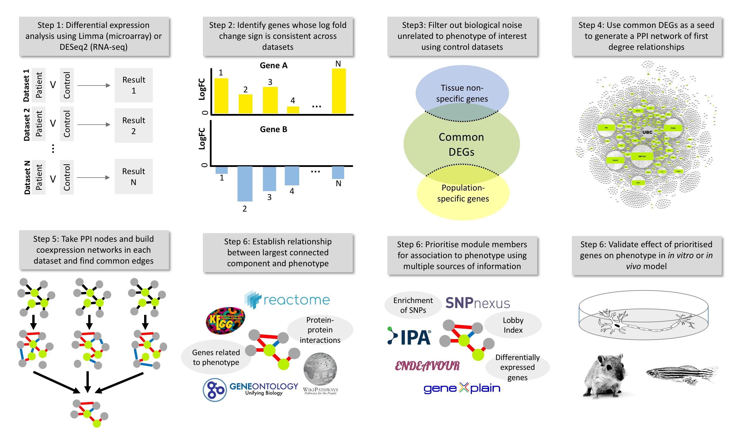

Slide 6
Datasets
CodeID | Tissue/Cell type | Variant | Samples | Type of array | GEO Ref
DIJ | Substantia Nigra | not specified | 15 disease, 8 control | Affymetrix Human Genome U133 Plus 2.0 Array | GSE49036
FFR | Substantia Nigra | not specified | 9 replicates for the controls and 16 replicates for the Parkinson’s disease patients | Affymetrix Human Genome U133 Plus 2.0 Array | GSE7621
MOR.SN | Substantia nigra, split into medial and lateral portions | sporadic | 15 samples of medial parkinsonian SN, 9 samples of lateral parkinsonian SN (24), 8 medial nigra control samples and 7 lateral nigra control samples(15) | Affymetrix Human Genome U133A Array | GSE8397
MID1 | Substantia Nigra pars compacta | not specified | 10 PD brain samples and 8 control | Affymetrix Human Genome U133 Plus 2.0 Array | GSE20141
MID2 | Whole substantia nigra | not specified | 18 controls, 11 patients | Affymetrix Human Genome U133A Array | GSE20292
DUM | Cortex (BA9) | not specified | 29 PD, 44 neurologically normal controls | Illumina HiSeq 2000 | GSE68719
MOR.FC | Frontal cortex | sporadic | 3 Controls 5 Patients | Affymetrix Human Genome U133A Array | GSE8397
LEW | Dorsal Nucleus of the Vagus Nerve | not specified | 6 PD samples and 4 controls | Affymetrix Human Genome U133A 2.0 Array | GSE19587
MID3 | Prefrontal cortex | not specified | 15 controls 14 patients | Affymetrix Human Genome U133A Array | GSE20168
MID4 | Putamen | not specified | 20 controls and 15 patients | Affymetrix Human Genome U133A Array | GSE20291
BOT1 | Locus Coeruleus | LRRK2 | 4 controls and 2 patients | Affymetrix Human Exon 1.0 ST Array | GSE34516
BOT2 | Putamen | LRRK2 | 5 controls and 3 patients | Affymetrix Human Exon 1.0 ST Array | GSE23290

Slide 7
Common DEGs
Started with 364 genes
Filtered out gene overlap with
Familial blood signature (PARKIN, ATP13A2, and PINK1)
Sporadic blood signature (2 datasets)
ALS signature (5 datasets)
Finished with 210 genes (100 up, 110 down)
Genes of note include
PD – SNCA, MSX1, CYCS, SPR, ALDH1A1, UCHL1
Mitochondrial complex I deficiency – NDUFV2, NDUFS1, NDUFS3, TMEM126B
AD – RTN4, MAP1B, CASP7
ALS – CHMP2B, SERTAD3, PAWR, MRPS22, TUBA4A
Maple Syrup Urine Disease – BCAT2

Slide 8
Common DEG functional enrichment
Upregulated
Not a particularly clear signal
Signalling pathways (TGF-beta, Ras, PI3K-Akt), apoptosis
Downregulated
Parkinson’s disease pathways
Mitochondrion (GOCP 4.7e-8)
Autophagosome/Lysosome (GOBP 3.3e-4)

Slide 9
Expand cDEG list to Protein-Protein interaction
Find protein interaction partners for cDEG proteins
210 DEGs → 2158 proteins
Enriches for a lot of pathways
Mitochondrion (4.223e-19)

Slide 10
Finding common coexpression modules
Run coexpression analysis on nodes from PPI network in each dataset
Datasets removed – those with < 4 samples (unfortunately inc LRRK2), RNA-seq (missing edges), and non-normal Rho distribution (2 datasets)
7 datasets left
Edges coexpression direction must be consistent
Rho value must be <-0.5 or >0.5 <-0.3 or >0.3

Slide 12
Parkinson’s Disease
Alzheimer’s Disease
Mitochondrial Complex I Deficiency
DEG
82 genes
95 edges

Slide 13
Functional Enrichment of PD Nugget
Citrate Cycle (7/22 genes, 32%, padj = 4.554e-9)
Parkinson’s Disease (9/142, 6%, padj = 3.598e-7)
Mitochondrion (19/919, 2%, padj = 2.491e-7)
Proteasome (5/44, 11%, padj = 2.0e-5)
Notes:
Functional

Slide 14
Recreate the network in controls

Slide 15
Gene prioritisation
LOF Mutation ❌
SNP Nexus ❌
Burden ❌
Lobby Index ✅
GeneXplain Regulator ✅
IPA Affector ❌
DEG ✅
LRRK2 PPI ❌
Endeavour ✅

Slide 16
GWAS hits
Not a sausage
GWAS Catalog – 249 genes associated with a SNP p <5e-8
Chang et al 2017 - 72 genes associated with 35 loci p <5e-6
Need to find Project Mine equivalent dataset

Slide 17
Things to do:
Run stats (RPTs)
Try and find GWAS dataset for LOF/SNP Nexus/Burden analysis
Find IPA effector relationships
Consider a third application
Rheumatoid Arthritis/
Fatigue

